Slide 1
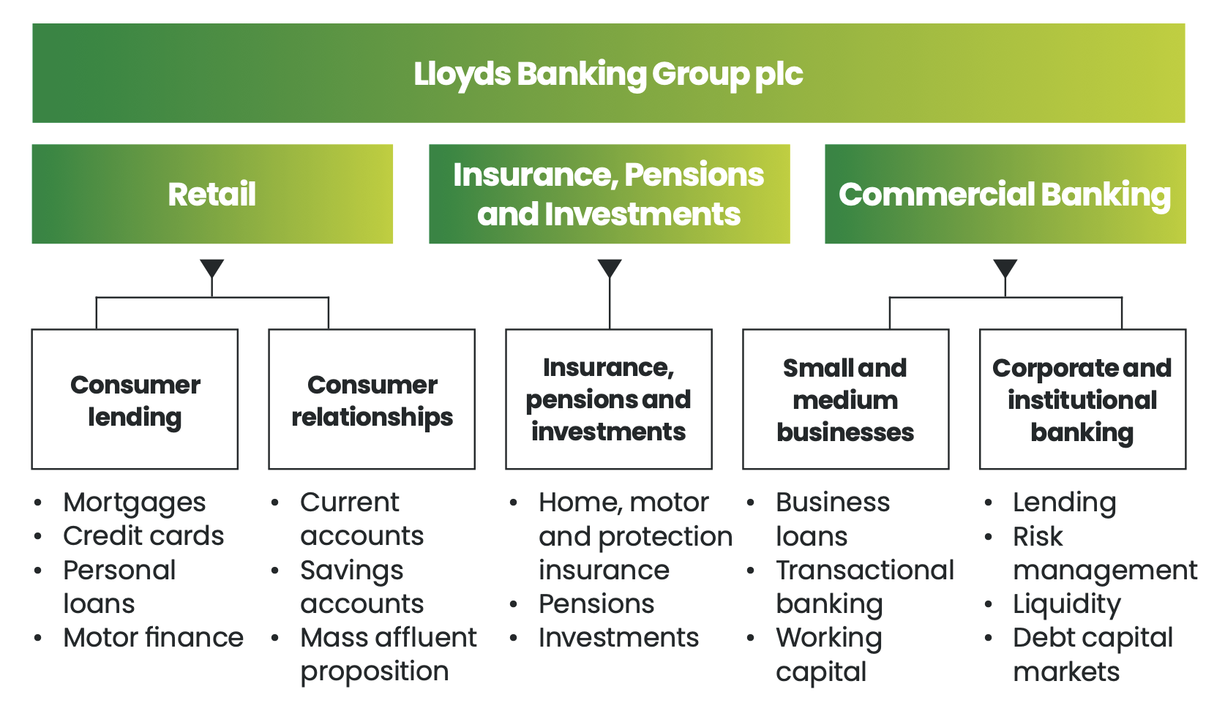
Lloyds
Notes:
We have three core divisions and, in line with our new strategy launched in 2022, we have restructured our business to optimise synergies
and efficiencies to best serve our customers’ needs.

Slide 2
Payment type | Daily limit
Faster Payments Payments to another UK account will normally be sent this way. | Online: up to £25,000 In branch: up to £250,000 with valid identification Phone: up to £25,000 Your limit includes payments you set up for a future date and increases to existing future payments.
Standing orders Lets you regularly send a set amount of money to another account. | Online: up to £25,000 In branch: up to £100,000 Phone: up to £25,000 Your limit includes new standing orders and increases to existing standing orders.
Cash withdrawals Take cash from your account. | Cash machines or cashback: up to £800 In branch: no limits, but please order large amounts in advance.

Slide 3
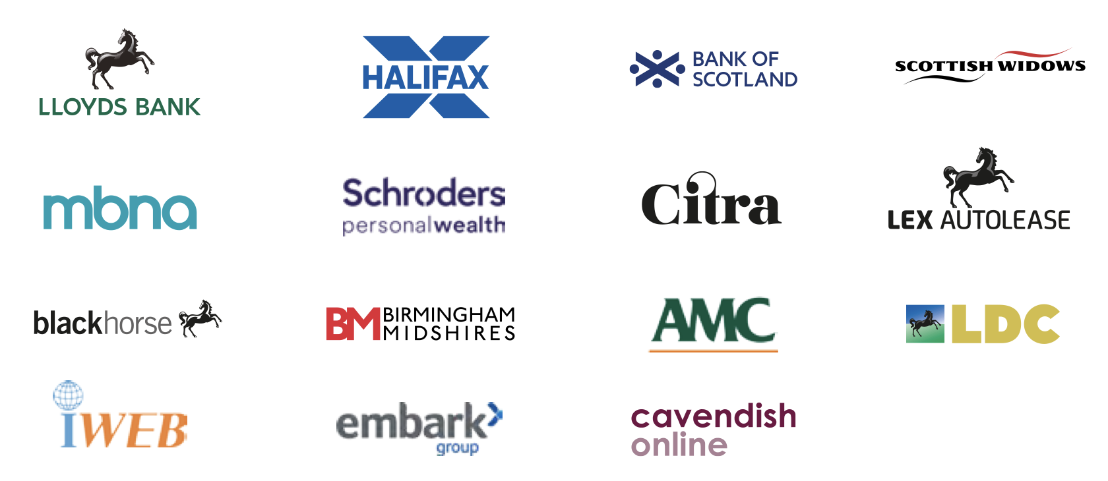





Schroders Personal Wealth is a financial advice firm backed by UK banking giant Lloyds Banking Group
and leading investment manager Schroders. Schroders Personal Wealth offers holistic,
financial planning services to UK customers on a restricted advice basis.
Part of Lloyds Banking Group, Embark is an investment platform and retirement solutions provider supporting financial
advisers and businesses in the UK.
Cavendish Online is an online investment platform and financial advisory service.
Lex Autolease is vehicle leasing company providing fleet management and vehicle leasing solutions.
LDC: Lloyds Development Capital, the private equity arm of Lloyds Banking Group,
specializing in supporting management buyouts, equity release, and growth capital for UK-based companies.
Notes:
Our trusted brands
Our products and services are made available to our customers through our trusted brands, which enables us to address the needs of different customer segments more effectively.

